Slide 1
Introduction to Quantum Computing
Dr. Thyagaraju G S
Professor and HoD, Department of CSE,
SDM Institute Of Technology, Ujire-574240

Slide 2
Topics :
Introduction to Quantum Computing
Why Quantum Computing?
What is Quantum Computing ?
Fundamental Principles of Quantum Computing
Qubits
Introduction to Python Qiskit
Quantum Gates and Quantum Circuits
Introduction to Quantum Algorithms
Future Directions and Research Opportunities

Slide 3
1.0 Why Quantum Computing?

Slide 4
1.1 Primary reasons
Enhanced Problem-Solving/Computing Capabilities
Solving complex problems that involve numerous variables and uncertainties
Exponential Scaling
Power of quantum computers increases exponentially with the addition of qubits
Energy Efficiency
Lower energy consumption and reduced carbon emissions
Communication
Provide better security and improved long-distance communications,
Sensing
Extremely precise measurements

Slide 5
1.2 Primary Applications
Chemistry and Materials Science
Aiding in drug discovery and materials development
Logistics and Optimization
Optimize logistics and route planning
Cryptography
Quantum-resistant algorithms, secure communication networks using quantum key distribution (QKD)
4. Artificial Intelligence
Handling complex datasets and Models
5. Weather Forecasting and Climate Change/Disaster Management
by simulating complex atmospheric and oceanic systems more accurately

Slide 6
3.0 What is Quantum Computing ?

Slide 7
3.1 What is Quantum ?
The term "quantum” (plural: quanta) originates from the Latin word for "how much.“
Quantum refers to the smallest possible discrete unit of any physical property, usually related to energy and matter.
Example :
A quantum of light is a photon, and
A quantum of electricity is an electron
Quantum Particles
Fermions (Particles that make up matter): Electrons , Protons , Neutrons, Quarks, Neutrinos
Bosons (Force-carrying particles): Photons, Gluons, W and Z Bosons, Higgs Boson, Gravitons (Theoretical)
Composite Particles: Mesons, Baryons

Slide 8
3.2 What is Quantum Computing?
Quantum computing is a type of computing that leverages the principles of quantum mechanics to process the information.
Quantum mechanics is the theory that describes the behavior of microscopic systems, such as photons, electrons, atoms, molecules, etc.

Slide 9
Principles of Quantum Mechanics (Unique Characteristics of Quantum Particles)
Wave-Particle Duality
Superposition
Entanglement
Quantization
Uncertainty Principle
Probability and Wave functions

Slide 10
4.0 Fundamental Principles of Quantum Computing
4.1 Qubits
4.2 Superposition
4.3 Entanglement
4.4 Quantum Interference
4.5 Decoherence
4.6 Quantum Tunneling
4.7 Measurement and Collapse

Slide 11
4 Core Components of Quantum Computer
A quantum computer is a device that exploits quantum mechanical phenomena, such as superposition and entanglement, to perform computations.
Qubits
Quantum Registers
Quantum Gates
Quantum Circuits
Quantum Processing Unit (QPU)
Measurement Devices

Slide 12
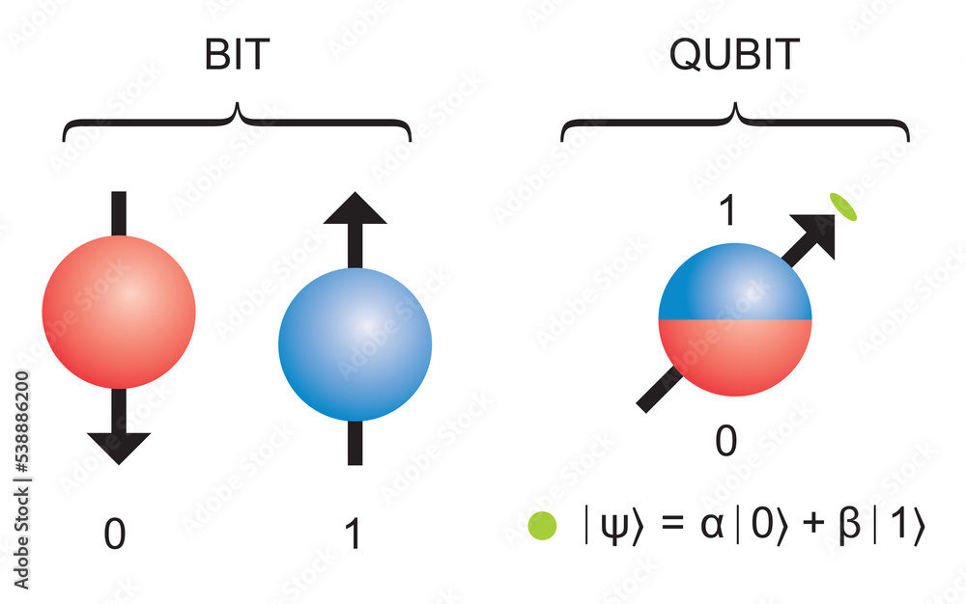
1. What is a Qubit?
A qubit, or quantum bit, is the fundamental unit of information in quantum computing, analogous to a classical bit in traditional computing.

Slide 13
Key Characteristics of Qubits
Superposition: A qubit can exist in a superposition of both states simultaneously. This means that a qubit can represent 0, 1, or any combination of the two at the same time.
Mathematically, a qubit can be expressed as:∣ψ⟩=α∣0⟩+β∣1⟩
where α and β are complex numbers representing the probability amplitudes of the qubit being in state |0⟩ or |1⟩, respectively.
Entanglement: Qubits can be entangled, meaning the state of one qubit is directly related to the state of another, regardless of the distance separating them.
Measurement: When a qubit is measured, it collapses from its superposition state to one of the basis states (either |0⟩ or |1⟩). The outcome of the measurement is probabilistic.

Slide 14
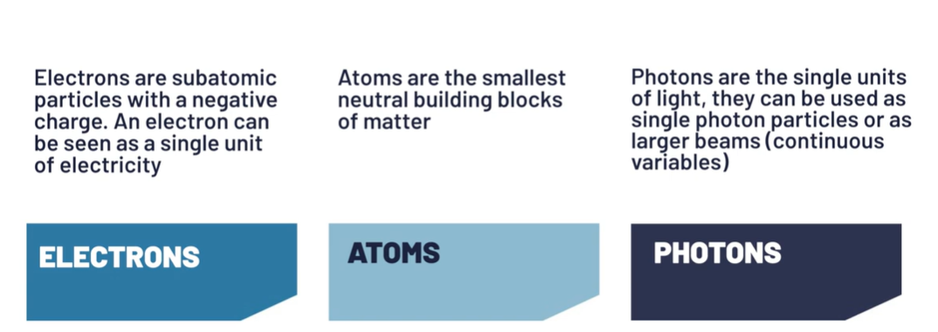
Type of particles used to build Qubits

Slide 15
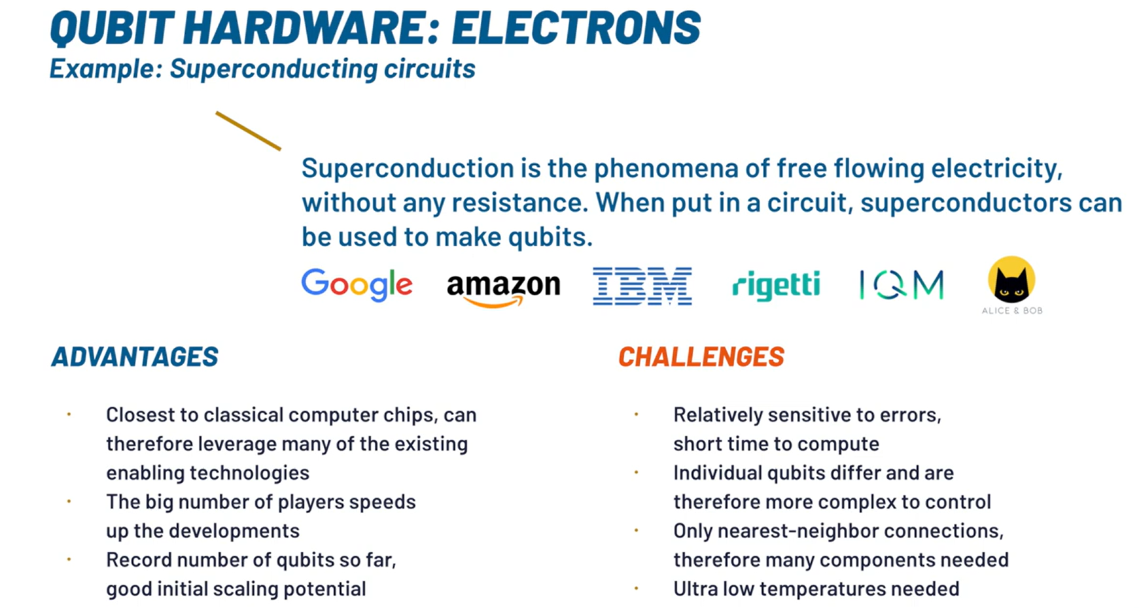
Superconducting qubits: IBM creates transmon qubits using niobium and aluminium on a silicon substrate

Slide 16
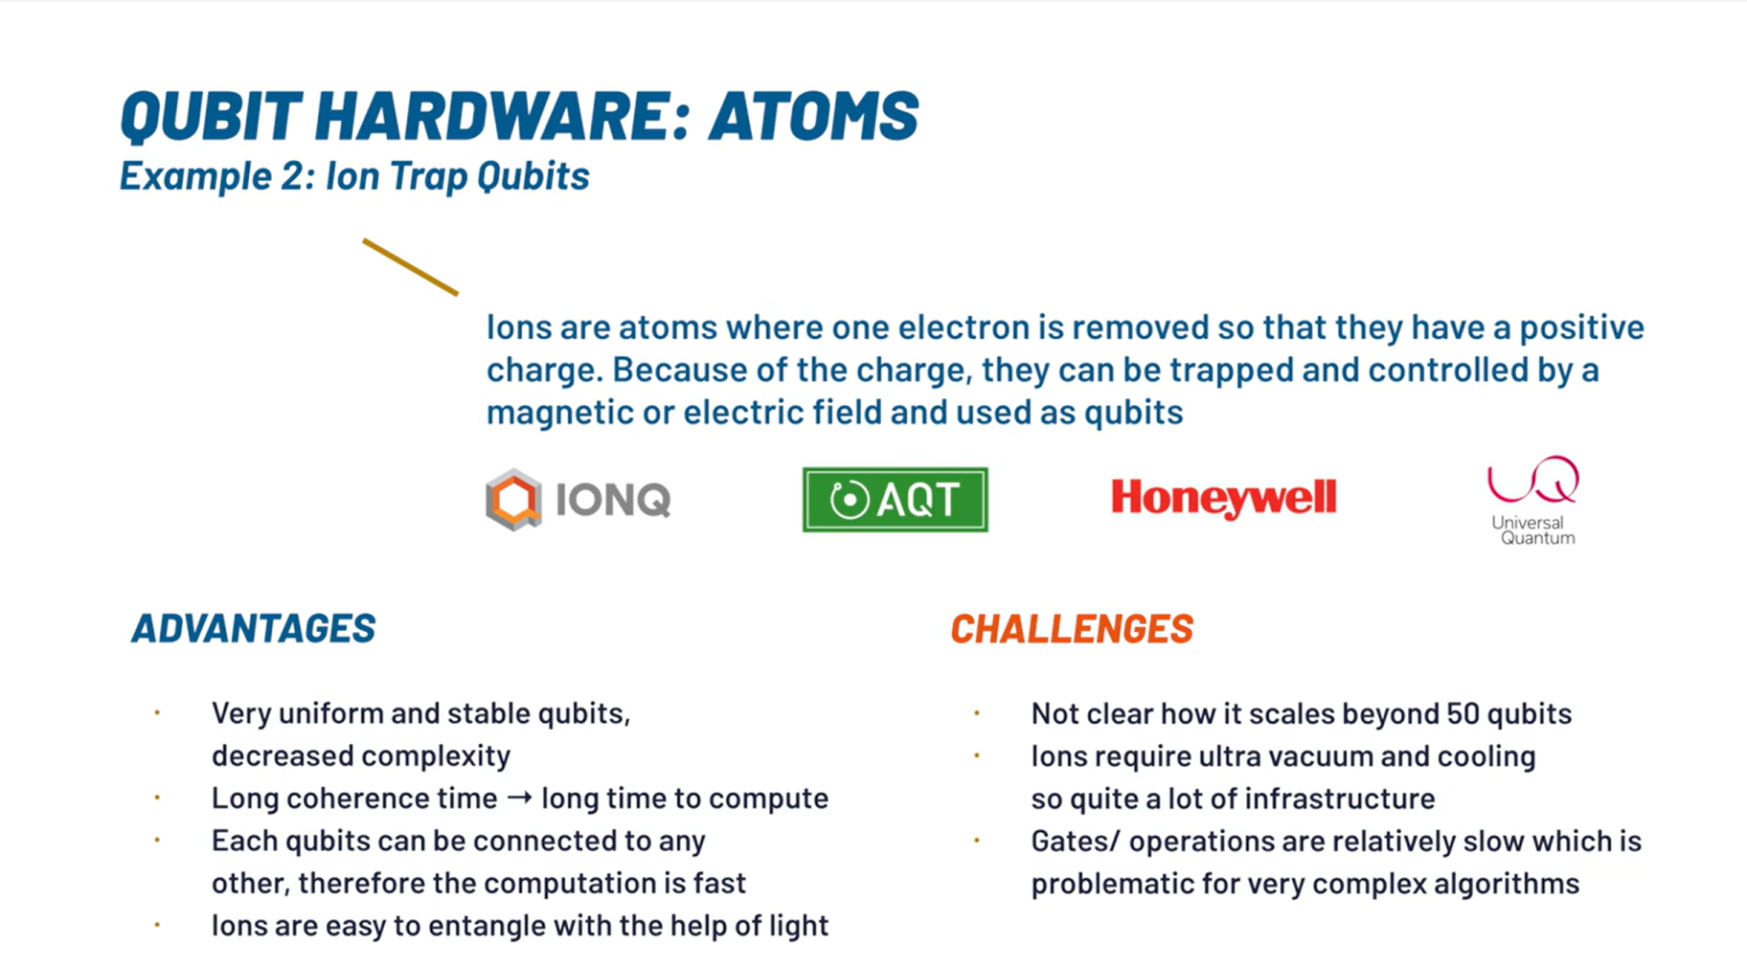
Trapped –ion qubits: Quantinuum and IonQ create qubits using ionized ytterbium atoms

Slide 17
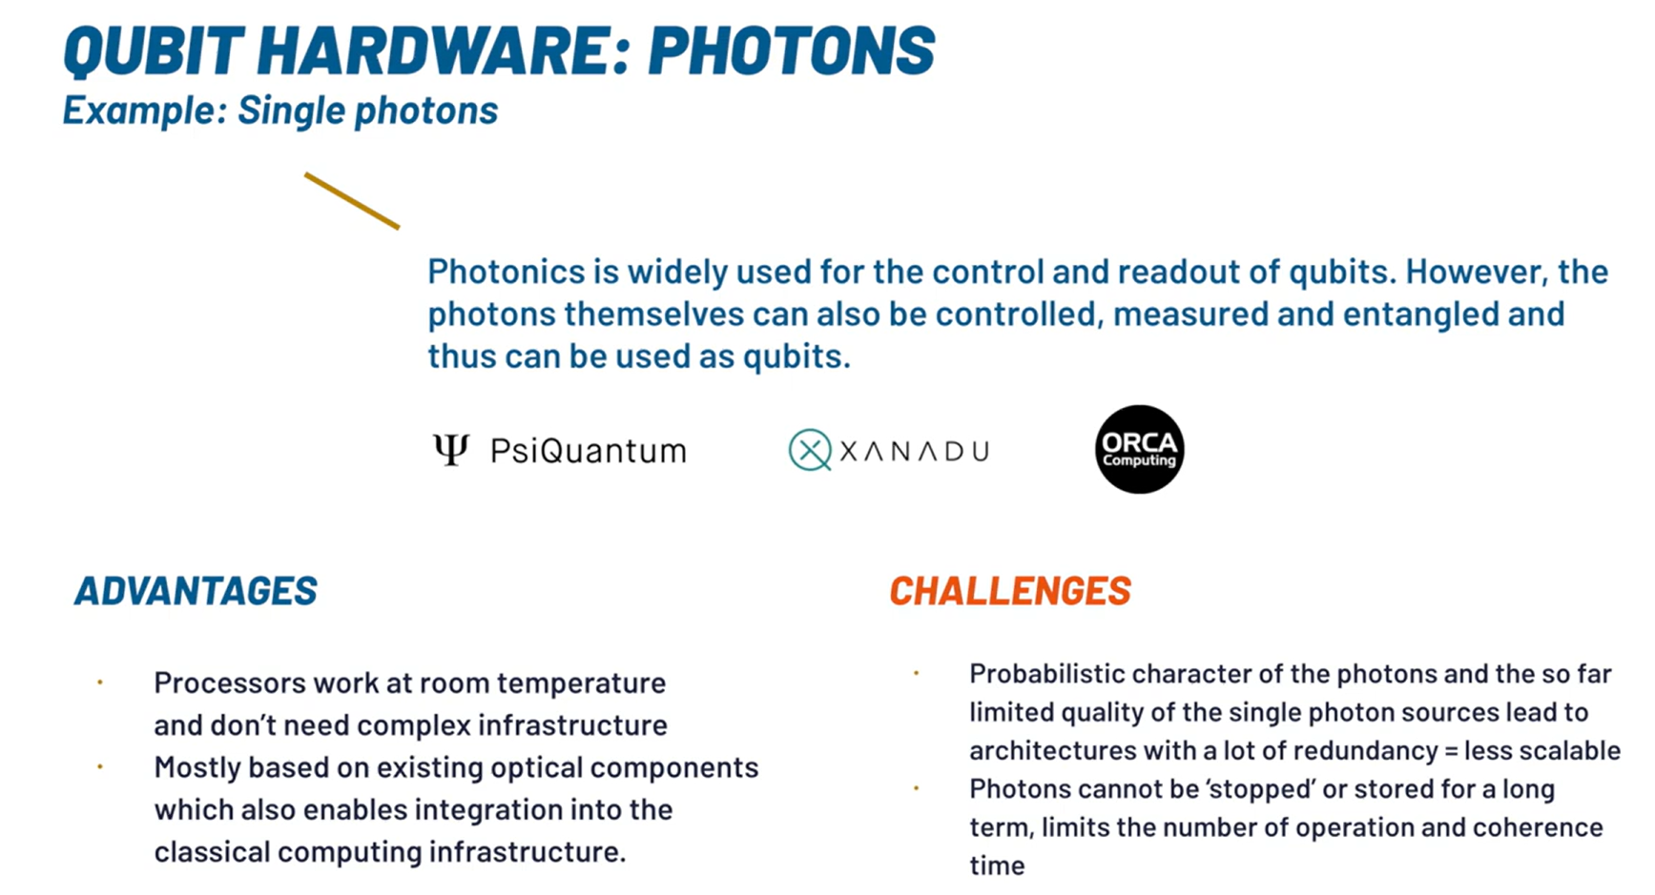
Xanadu creates qubits by squeezing laser light using ring resonators

Slide 18
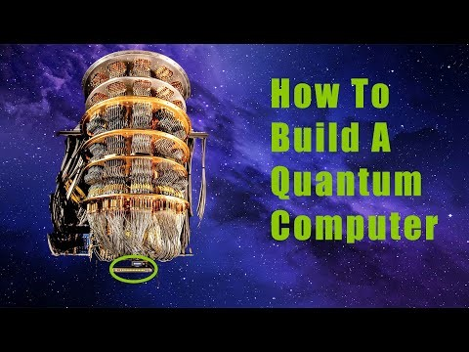
Video1 : How to build Quantum Computer

Slide 19
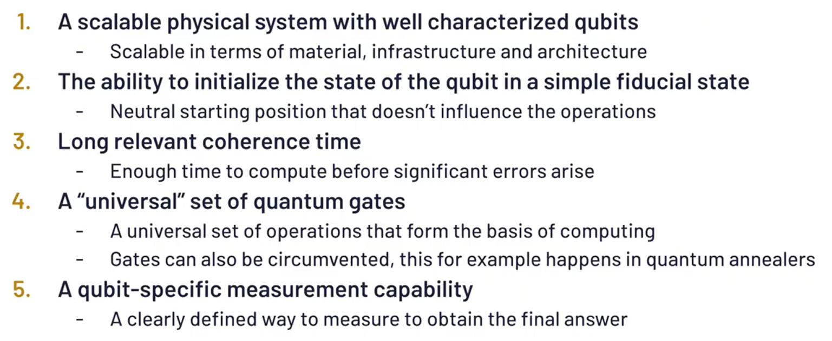
QC Hardware : Basic Requirements

Slide 20
Year | Qubit Size | Milestone
1998 | 9 | First demonstration of quantum error correction using 9 physical qubits to encode 1 logical qubit.
2016 | 5 | IBM introduces the 5-qubit IBM Q 5 Tenerife and IBM Q 5 Yorktown processors.
2017 | 14 | IBM launches the 14-qubit IBM Q 14 Melbourne processor.
 | 16 | IBM introduces the 16-qubit IBM Q 16 Rüschlikon processor.
 | 17 | IBM unveils the 17-qubit IBM Q 17 processor.
 | 20 | IBM releases the 20-qubit IBM Q 20 Tokyo processor.
2018 | 20 | IBM releases the 20-qubit IBM Q 20 Austin processor.
 | 50 | IBM introduces the 50-qubit IBM Q 50 Prototype.
2019 | 53 | IBM launches the 53-qubit IBM Q 53 processor.
 | 53 | Google claims quantum supremacy with its 53-qubit Sycamore processor.
2020 | 27 | IBM achieves a Quantum Volume of 64 with a 27-qubit processor.
2021 | 127 | IBM releases the 127-qubit IBM Quantum Eagle processor.
2022 | 433 | IBM unveils the 433-qubit IBM Quantum Osprey processor.
2023 | 1,121 | IBM presents the 1,121-qubit IBM Quantum Condor processor.
 | 1,305 | Researchers at TU Darmstadt demonstrate a 1,305-qubit array based on optical tweezers.
 | 1,180 | Atom Computing announces a 1,180-qubit array based on Rydberg atoms.
2024 | Up to 8 | Researchers fuse small quantum states into states with up to eight qubits.

Slide 21
Challenges and Considerations
Decoherence: Quantum systems are sensitive to their environment, and maintaining coherence is critical for reliable computations.
Error Correction: Quantum computations are prone to errors, necessitating the development of quantum error correction codes and fault-tolerant techniques.
Scalability: As quantum computers grow in size and complexity, challenges related to maintaining qubit coherence and reducing noise become increasingly significant.

Slide 22
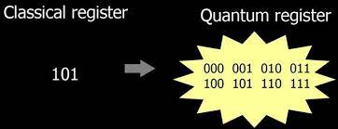
2. Quantum Register
A quantum register is a system comprising multiple qubits, serving as the quantum analogue of the classical processor register.

Slide 23
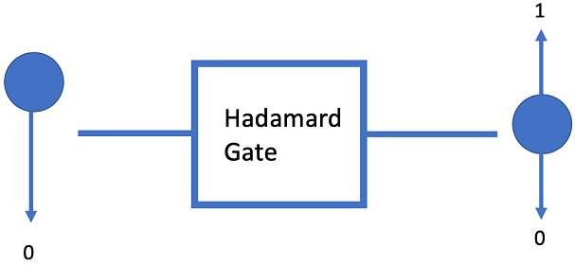
3. Quantum Gates
Quantum gates are the basic building blocks of quantum circuits, and they are used to manipulate the quantum state of qubits. A quantum gate is a mathematical operation that acts on the state of one or more qubits, and it can be represented by a matrix.

Slide 24
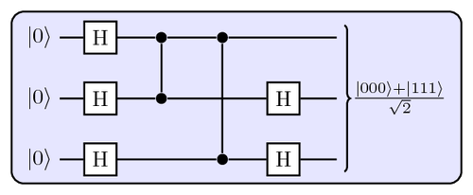
4. Quantum Circuits
Quantum circuits are composed of quantum gates and are used to perform quantum algorithms.
A quantum circuit is a series of quantum gates that act on one or more qubits.
The gates are arranged in a specific order, and the circuit is executed in a specific sequence.

Slide 25
5. Quantum Processing Unit
A quantum processing unit (QPU) is a computational unit that relies on quantum principles to perform a task. The QPU includes the:
QRAM (register + gates)
Quantum control unit (QCU) which drives the system to the desired state.
Classical controller interface which defines the interaction between the host CPU and the QPU

Slide 26
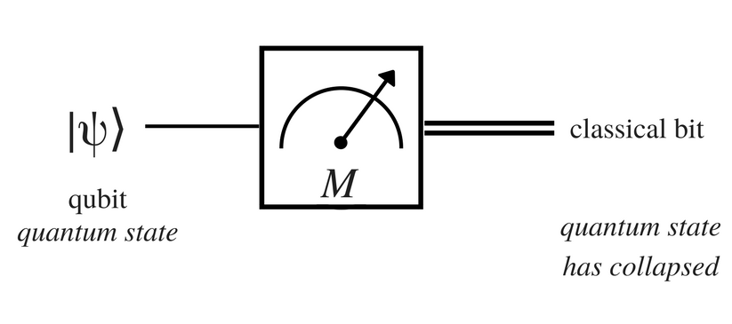
6. Measurement Devices
Quantum measurement is all about obtaining information about the state of a quantum system
Quantum Sensors, Quantum Microscopes, Quantum Clocks and Frequency Standards, Quantum Gravimeters and Gyroscopes.

Slide 27
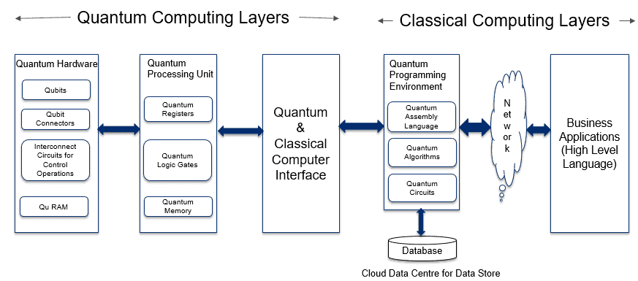
3.3 Architecture of Quantum Computer
1. Application Layer 2. Classical Processing Layer 3. Quantum Computing Layers

Slide 28
Quantum Computer Cooling Systems
Quantum bits, or qubits, typically operate at extremely low temperatures to maintain their quantum states and minimize thermal noise.
The operational temperature for most superconducting qubits is around 10 to 20 milliKelvin (mK), which is just above absolute zero (approximately -273.15°C)
There are advancements in quantum technology that allow for operation at higher temperatures. For instance, silicon qubits have been shown to function at temperatures up to 10 Kelvin (K).

Slide 29
Quantum Computer Cooling Systems
Cooling System | Minimum Temperature Achievable | Type of Qubits
Dilution Refrigerator | ~10 mK (10 milliKelvin) | Superconducting qubits
Adiabatic Demagnetization Refrigeration (ADR) | < 2 K (2000 milliKelvin) | Various types of qubits
Pulse Tube Refrigeration (PTR) | < 4 K (4000 milliKelvin) | Superconducting qubits
Laser Cooling | Near absolute zero | Trapped ions, atomic qubits
2D Quantum Cooling System | 100 mK (100 milliKelvin) | Various types of qubits
Immersion Cooling with Helium-3 | < 1 K (1000 milliKelvin) | Superconducting qubits

Slide 30
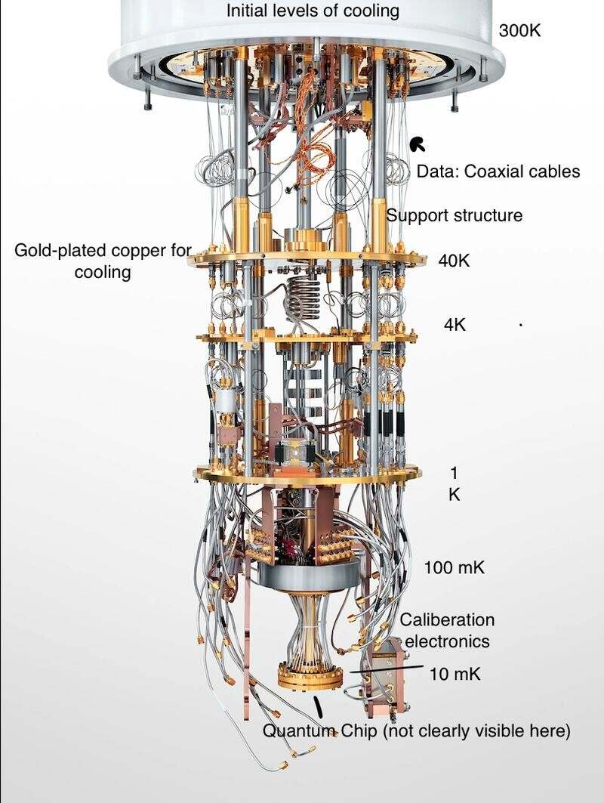

Slide 31
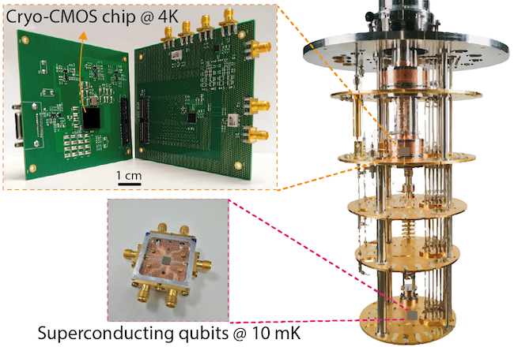

Slide 32
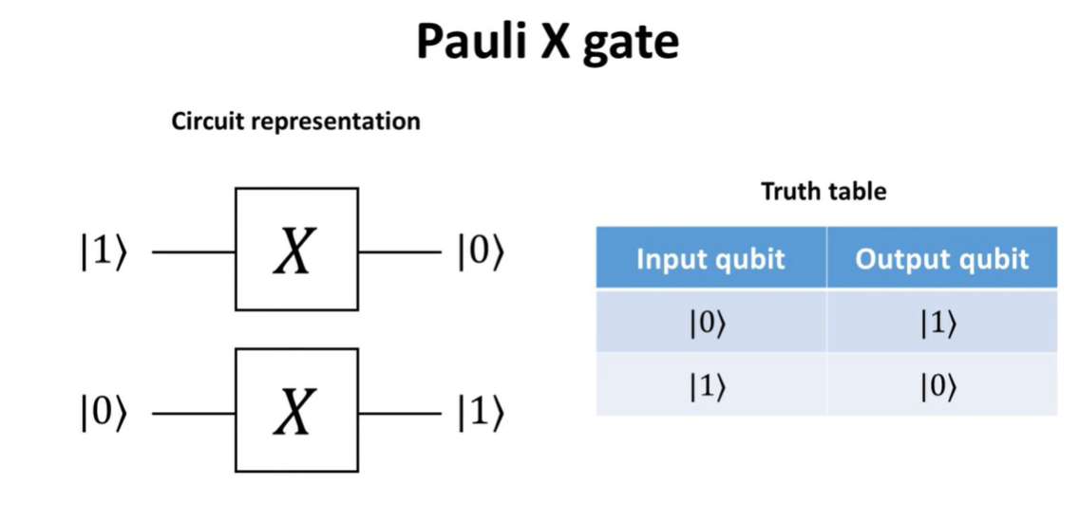

Slide 33
References
Qiskit | IBM Quantum Computing
Qubits: What is a Qubit and How Qubits Work? - MAKB Tech (makb183.com)
Qubit (devopedia.org)
Cryogenic measurements of semiconductor devices - NPL

Slide 34
References
Google's Quantum Lab in California holds the future of computing (youtube.com)
Quantum Computers, explained with MKBHD (youtube.com)
The Map of Quantum Computing - Quantum Computing Explained (youtube.com)
Quantum Computing Hardware - An Introduction (youtube.com)
Decoded: How Does a Quantum Computer Work? (youtube.com)
Quantum Computing: Algorithm, Programming and Hardware, an Introduction (youtube.com)
Inside a Quantum Computer! with Andrea Morello (Part 1 of 2) (youtube.com)
L2-1 Quantum Computing Hardware: An Overview (youtube.com)
What Would a Quantum Internet Look Like? (youtube.com)

Slide 35
References
Mapping the qubit state onto the Bloch Sphere (youtube.com)

